Slide 1
Python for Analytics
Tata Institute of Social Science, Mumbai

Slide 2

Sunit Jadeja
Data Scientist, ThermoFisher Scientific (June, 2022- )
MA Data Analytics, TISS, Mumbai (2020 - 2022)
Tech Consultant Intern, Ernst & Young, Mumbai (January, 2022 - June, 2022)
Data Science Intern, ITC, Kolkata (May,2021 - August,2021)
HR Analyst Intern, TMI, Hyderabad (December, 2020 - February, 2021)
Sales Manager, Quikr, Mumbai (2018 – 2020)
B.B.A, Ahmedabad University (2014-2017)
https://github.com/Sunit-Jadeja
https://public.tableau.com/app/profile/sunit.jadeja

Slide 3
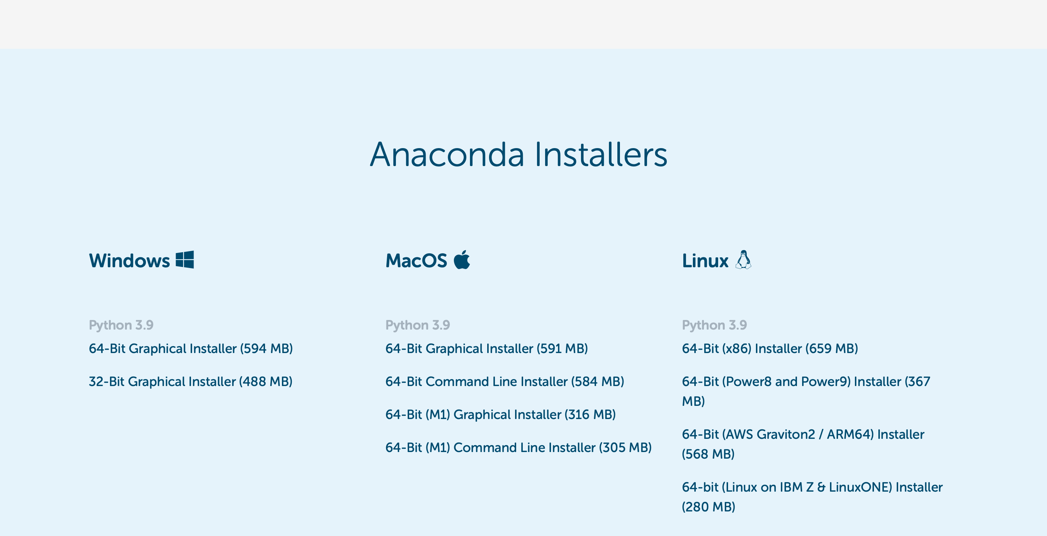
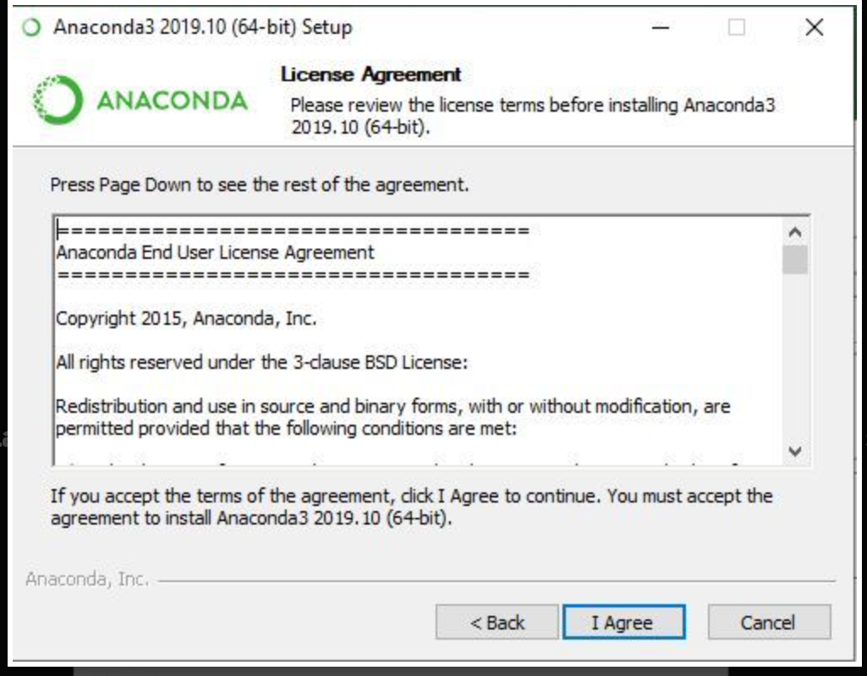
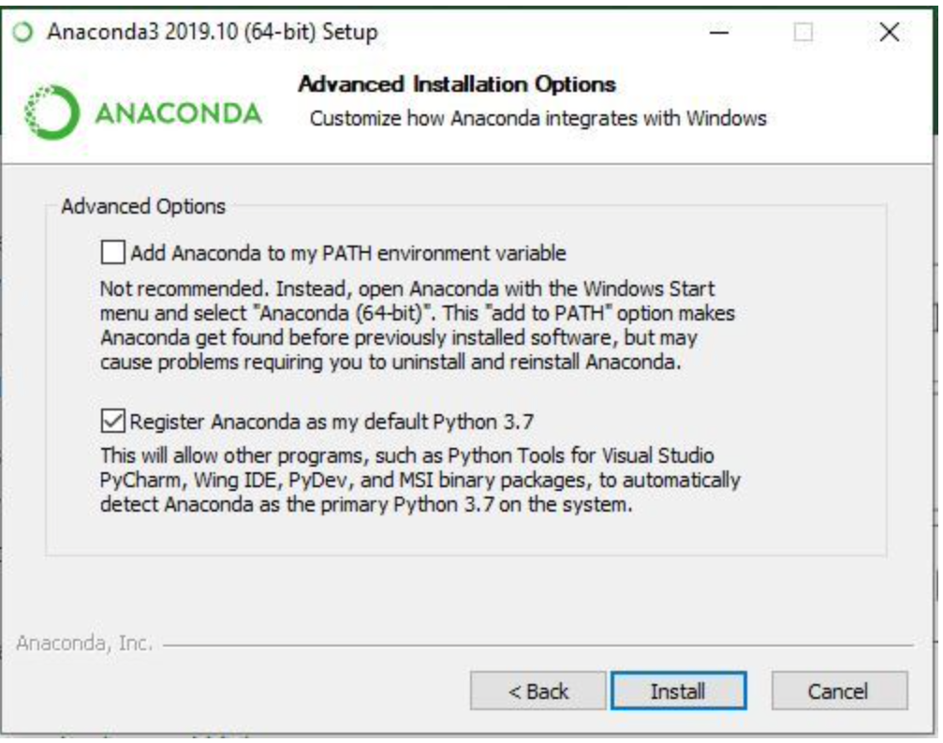
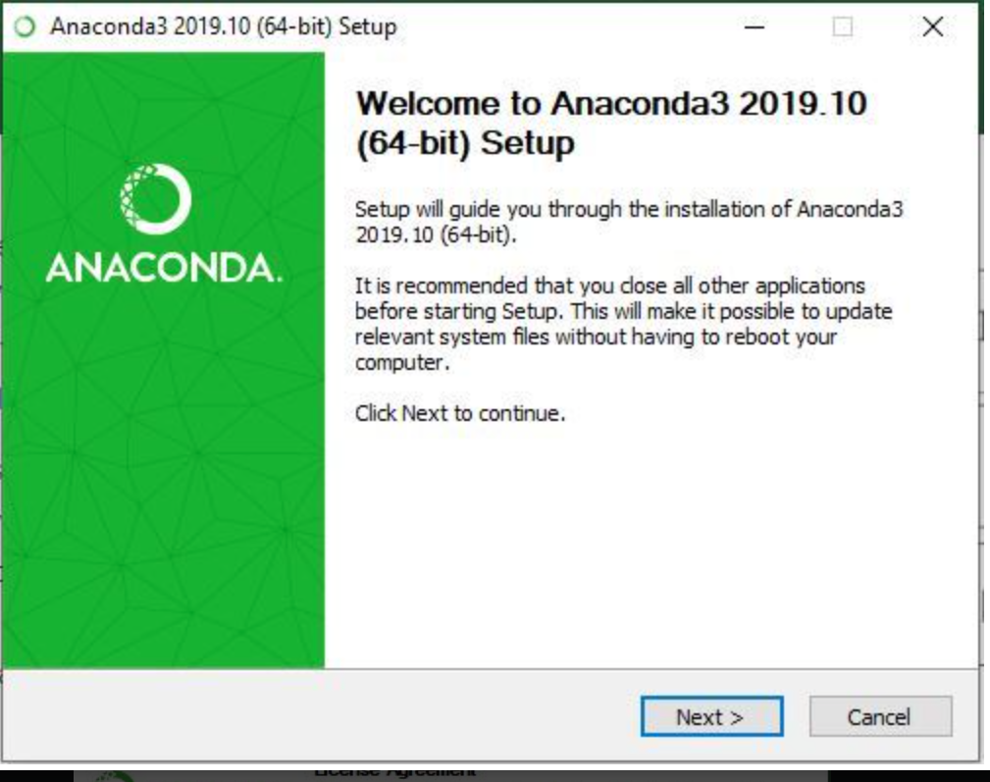
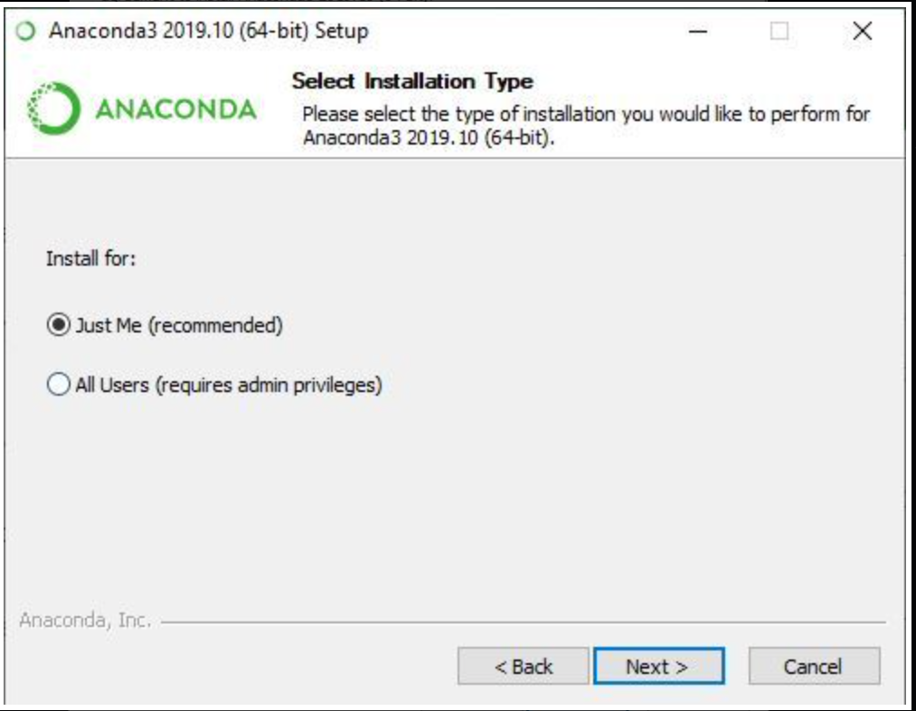
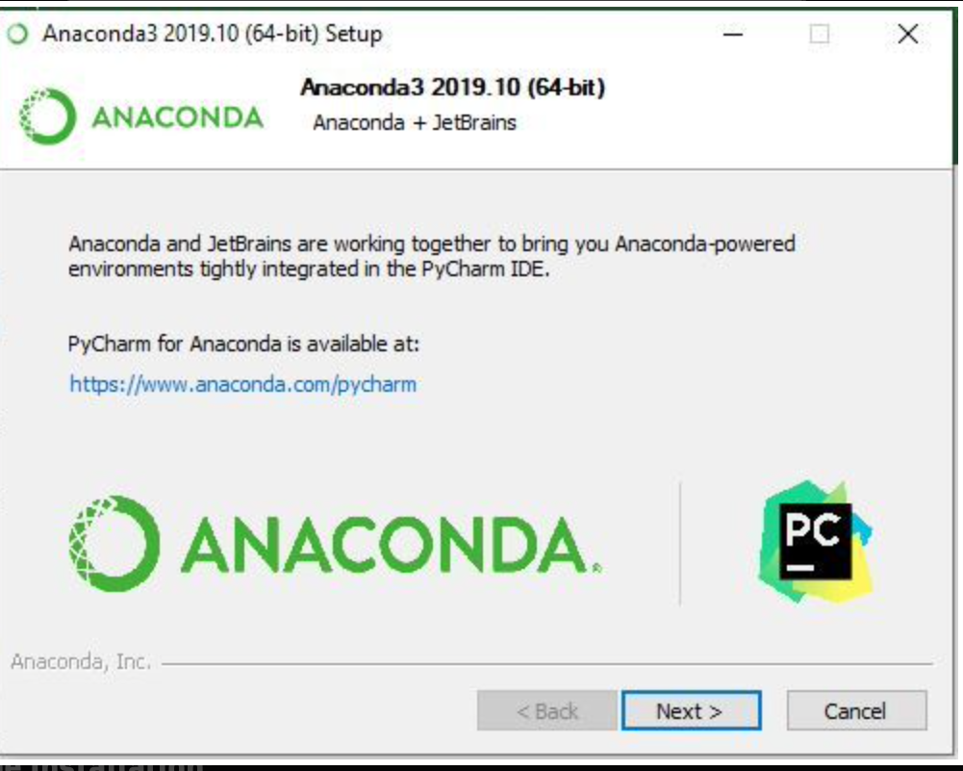
Python Installation https://www.anaconda.com/download
Step 1
Step 3
Step 5
Step 2
Step 4
Step 6

Slide 4
What is Big Data?
Big data refers to 3 V’s
Velocity: Speed at which data is being generated
Volume: More & More data is being generated according to International Data Platform around 177 Zettabytes of data is being generated in a year.
Variety: Different types of data (structured & unstructured and different types within them)

Slide 5
What is Data Science?
Artificial Intelligence (AI): Computers performing tasks that would typically need human intelligence.
Machine Learning (ML): It is a subset of AI works well with structured data. Goal is to find pattern in the data given to it, without specifying by human.
Supervised ML: Prediction values label are available.
Unsupervised ML: Label are not available.
Reinforcement Learning: Works as reward & punishment rule
Deep Learning: Subset of ML that uses set of algorithms structured like human brain known as neural network. Works well with complex data like images, sequences & natural language.
Data Science: Combines tools & workflows from disciplines like math, statistics & math, computer science & business to process, manage & analyse the data.

Slide 6
Workflow of Data Science Projects
Data Science Workflow
EDA
Identifying Business Problem
Ingestion of Data
Preparing Data
Sharing Data Insights
AI (ML & Deep Learning)

Slide 7
Workflow of Data Science Projects
Identifying Business Needs: Businessperson comes up with problems & set of questions i.e. should we change our product? Which customers will be churning out? Etc.
Ingestion of Data: Organisations data structure to solve these problems Whether data is taken real time(Streaming) e.g. customer transaction or in a uploaded after a period of time (Batch) stored in some local file.
Preparing Data: Data munging also known as data cleaning after ingestion of data is completed. cleaned, aggregated, augmented, joining, extracting, filtering goal is to for machine learning or analyse it.
EDA: Explanatory Data Analysis, after data munging EDA is done which involves correlation, patterns, trends, past data insights etc.
AI & ML: Here we brainstorm with data science team to know which algorithm to use if ML which one if deep learning why etc.
Sharing Data Insights: Sharing insights from the data to the businessperson to make decisions. Through dashboards, PPT, Email etc.

Slide 8
Different Roles in a Data Science Team
Performance Administrators
Setting up, configuration & maintenance of big data infrastructure.
Data Engineers
Develop construct, test & maintain data pipelines
Data Scientist
Builds AI/ML process
Data Analyst
Extract insights from the data prepared by data engineer
Keeping track of how team is using big data platform
Good with database queries
Good with analytical tools & visualization
Automation
Good with math, statistics & programming language

Slide 9
Python History
Python is open source programming language that can be used in application programming & the scripting application across various domains.
Python is free
Python is portable (works on multiple operating system same code)
Easy to learn because of readability & quality
Python is a case sensitive language
Python is a function oriented language
Python was conceive in 1989 by Guido Van Rossum
1990 first version Python 1.0
2000 Python 2.0
2008 Python 3.0
!python --version
Python is widely used in AI, ML & Data Science etc

Slide 10
Why Python?
Python code are well formatted as formatting is enforced as rule in python, if unformatted code is written then error message is written
Readability
Uniform
Python
Software Quality
Support Library
Program Portability
Developer Productivity
Dynamic Typing: No need to declare variables.
Less Code Size: Less to type, debug & maintain.
using namespace std;
int main ()
{int a=10
Cout <<”Hello World”;
Return;}
Supports 3rd Party Library
Website Development
Numerical Programming (Numpy)
Can run in all major platform like Windows, Linux
Without any changes in code which saves time of developer

Slide 11
What Can Be Done in Python
AI/ML
Regression
Classification
Reinforcement Learning
NLP
Database Programming
MySQL
PostreSQL
Oracle
Data Analysis
Numpy
Pandas
Data Visualization
GUI (Front End Development)

Slide 12
Python is a Function Oriented Language
Built in Function | Module Functions | Library
Functions those are available the moment you install the Python | Collection of function (A like minded function can be formed into a module) | Collection of module is called a library
dir(__builtin__) | import math help(math) | Pandas Numpy

Slide 13
Python Built in Data Type
Data Type | Example
Numbers | 1234, 1.234,1+2J, ,fraction, decimals
String | “hello world”, ‘hello world’
Lists | [1,2,3] [1,2,3,”hello world”,5]
Dictionaries | {‘a’:1 , ‘b’:2}
Tuple | (1,2,3) (1,2.4,”hello world”,5)
Sets | {‘a’,’b’,’c’}
file | Open[hello_world.txt]
Others | Class, Boolean, function

Slide 14
Numbers
Float
Integer
Complex number
Arithmetic Operations
random & math module
Help
pi, factorial
randint(1,10)

Slide 15
String
Indexing [0], [-1]
Slicing [0:3]
Find
Replace
Split
Upper
lower

Slide 16
List
List is a ordered collection (Indexing) of different or similar type of object
Index [0]
Slice [0:3]
List * 2
Append (“new value”)
Insert (3,”new value”)
Pop (3)
Remove (“new value”)
Extend

Slide 17
Dictionaries
Dictionaries are the most flexible built in data type in Python
Dictionaries, items are stored and fetched by key, instead of positional offset
Dictionaries use {}
Key and Value, MyDictionary= {‘a’:1, ‘b’:2, ‘c’: 3}
MyDictionary={}
MyDictionary[“a”]=1
MyDictionary[“b”]=2
Keys()
Values()
Update({“d”:4})
Pop()

Slide 18
Sets
A set is an unordered collection of items
Every element is unique (no duplicate) and must be immutable (which cannot be changed)
Used when we have two unique dataset and we need to compare them
setA=set("aabbccddddeeeeefffffg")
setB=set("eeffz")
& (intersection)
| (Union)
setA - setB

Slide 19
Tuple
A tuple is a sequence of immutable python objects like floating number, string, literals etc.
Tuples are defined using curve braces ()
Index
Slicing

Slide 20
Datatype
Mutable
List
Dictionaries
Immutable
Numbers
Sets
Strings
Tuple

Slide 21
Anaconda Navigator
Compound Statements
IF, ELIF & ELSE
Loops
While
For
Range, Enumerate & Zip
Range in Loop
Enumerate in Loop
Zip in Loop
List Comprehension
Function in Python

Slide 22
Compound Statements
Compound statement are statements that embed other statements.
IF is the compound statement that embeds other statements including IF.
E.g. IF, FOR, WHILE

Slide 23
Compound IF, ELIF & ELSE Statements
If test 1 condition is true then statement 1 will be executed
If Test1:
Statement 1
Elif Test2:
Statement 2
Else:
Statement 3
Multiple/Optional
If test 1 is false & test 2 condition is true then statement 2 will be executed
Multiple/Optional
If test 1 & test 2 are false conditions then statement 3 will be executed.

Slide 24
If Statement Question
More than 90 (excellent)
Less than 50 (poor)
Anything between 90-50 (Average)
My marks 75

Slide 25
Compound While Loop
While loop repeatedly executes a block of statements until the conditions is True. If the testing condition returns False then control comes out of While loop.
If test 1 return true then block of statement inside While loop is executed.
while Test 1:
Statement 1
Else:
Statement 2
Optional
If control does not come out of while statement because of Break then else will be executed

Slide 26
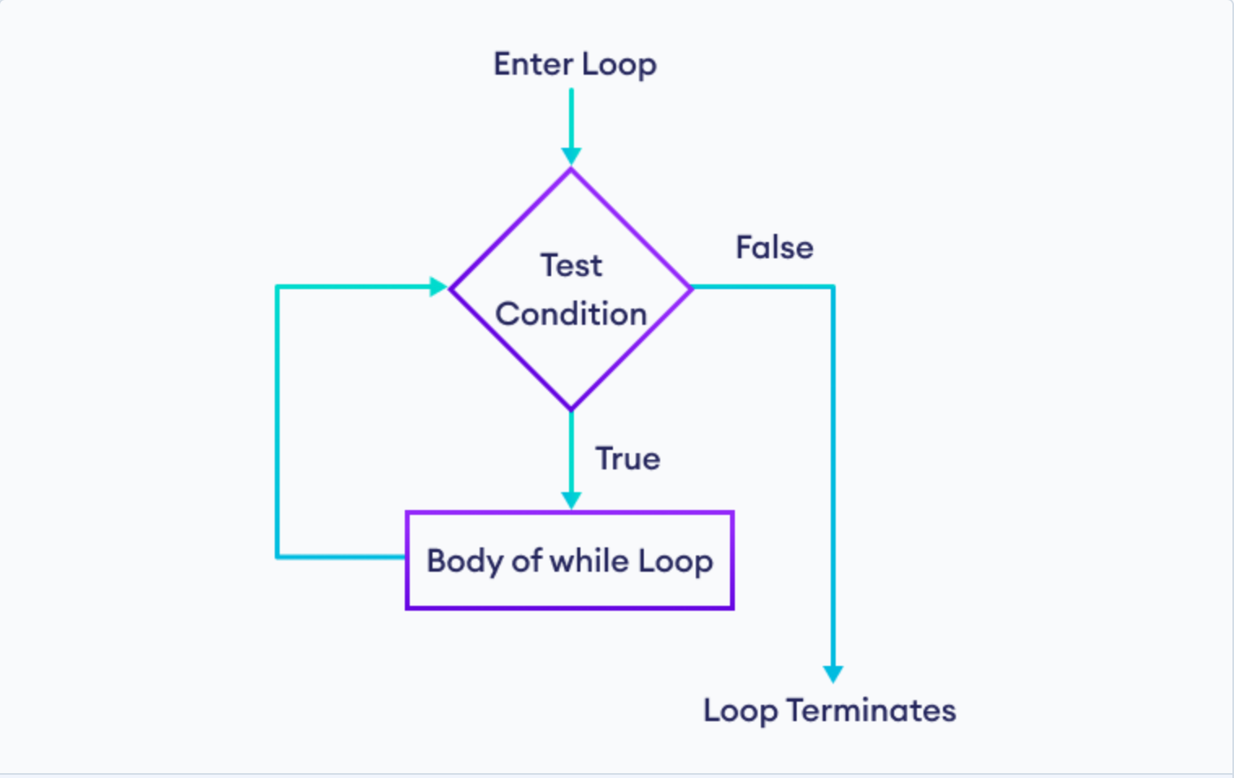

Slide 27
Compound For Loop
For Loop is generic iterator
It can step through the items in ordered sequence.
In each loop, items from ‘source object’ is assigned to ‘target object item’ and for loop statement blocks are run.
Assign one item from ‘source object’ to ‘target object item’
For target object item in:
source object item
print (statement)
Repeatedly loop with “target object items” assigned one by one from ‘source object item’

Slide 28
Range, Enumerate & Zip
Range is useful where you know how many times a looping function is going to iterate based on that you can iterate those function.
Zip allows us to combine multiple list into one with same index matching
Enumerate function returns a generator object
Zip returns offset & individual items. It generate both the values & indexes of items in an iterable we don’t need to count manually.

Slide 29
List Comprehension
List Comprehension is a way to create a new list.
List Comprehension is written inside a square bracket.
• Two parts to list comprehension
Expression (x*x)
Loop Variable & Iterable Object
Lst=[10,20,30,50]
Lst1=[x*10 for x in lst]
Expression
loop
Iterable object

Slide 30
Why List Comprehension When We Have Loop?
Easy to code in one line
Runs faster compared to loops

Slide 31
What is a Function in Python?
Function is block of statement that is grouped together so that they can be called multiple times from different part of the program.
In python, function is an object with a name

Slide 32
Why to Use Functions in Python?
Code Reuse
Allows to use same set of statement multiple times
Decompose Functionality
It provides a way to identify various functionality and create a functionality to be used at multiple places in the code.
Readability
It allows to generalize the common functionality making the code more readable
Less Lines to Code
Generalize instead of scattered piece of same code in program.

Slide 33
Components of a Function
Input
Argument global variable, file/stream
Function
Local Variable Function Logic
Output
Return statement
Mutable Argument

Slide 34
Python Function Syntax
Name of the function
Function starts with “def” keyword
def FunctionName (name):
print (“Hello”, name)
return
Function starts with “def” keyword
O/P
Function return value

Slide 35
Numpy
Numpy is an open source software short-form of Numeric Python.
Linear Algebra, Boolean and other mathematical operation.
Pip install numpy

Slide 36
What Can Be Done With Numpy
Data Science
Data Ingestion
Visualization
Matplotlib
Astronomy
Detection of gravitational waves
Machine Learning
Sci-kit learn
Modelling
Report in Dashboard
SciPy
TensorFlow
Seaborn
Plotly
First Black Hole Image

Slide 37
What & Why Numpy
Numpy is a foundation package for Numerical computing in python.
Efficient multi dimensional array that provides fast arithmetic operations and broadcasting capabilities.
Flexible mathematical function to work on entire array without loop
Various tools to read/write data to disk & working with memory mapped file.
Has capability to create random numbers, linear algebra and has transformation capabilities

Slide 38

Numpy Operations
Operations | Example
Array Creation | X= np.array([10,20,30,40,50]) Np.zeros(10), np.ones(10) Np.zeros((5,3)) Np.empty((2,3,2))
Array creating using data type | np.array([1.0,2.0,3.0,4.0,5.0], dtype=np.float64) np.array([10,20,30,40,50], dtype=np.int32)
Casting Data Type | X=np.array([10,20,30,40,50], dtype=np.int32) X=X.astype(np.float64)
Arithmetic Operations | arr1=np.array([[10,20,30],[20,30,40]]) arr3=np.array([[1,2,3],[4,5,6],[7,8,9]]) arr2=np.array([[1,2,3],[4,5,6]]) Same dimension of array print(arr1*arr2, arr1+arr2,arr1-arr2 ,arr1/arr2)
Indexing & Slicing | lst=[1,2,3,4] S=np.array([1,2,3,4])
Propagation & Broadcasting | S[0:2]=99 S[3]=99
Reshape | g=np.arange(32).reshape(8,4) g=np.arange(32).reshape(2,8,2)
Transpose | g1=g.transpose()

Slide 39
Array Creation
Arrays are fundamental of numpy
Multiple arrays can be created (1 dimension, 2 dimension, 3 dimension etc)
X=[10,20,30,40
X= np.array([10,20,30,40,50])
Np.zeros(10), np.ones(10)
Np.zeros((5,3))
Np.empty((2,3,2)) (first element is dimension, second is rows per dimension & third is column per dimension)

Slide 40
Basic Understanding of Arrays
multidimension=np.array([[10,20,30],[20,30,40]])
multidimension. Dim,
multidimension.shape,
multidimension.size,
multidimension.itemsize,
multidimension.nbytes,
multidimension.dtype

Slide 41
Array Creation & Casting Using Data Type
One can change data type in array by simple mentioning it in the array
np.array([1.0,2.0,3.0,4.0,5.0], dtype=np.int32)
np.array([10,20,30,40,50], dtype=np.float32)

Slide 42
Arithmetic Operations in Numpy
To do any arithmetic operation arrays should be of same size in dimensions rows & columns.
arr1=np.array([[10,20,30],[20,30,40]])
arr3=np.array([[1,2,3],[4,5,6],[7,8,9]])
arr2=np.array([[1,2,3],[4,5,6]])
Same dimension of array
print(arr1*arr2, arr1+arr2,arr1-arr2 ,arr1/arr2)

Slide 43
Indexing & Slicing
Indexing & Slicing is similar like List & Tuple data type of python
lst=[1,2,3,4]
S=np.array([1,2,3,4])
Indexing & slicing in multiple dimension
g=np.arange(48).reshape(3,8,2)
g[0,3,2]
The difference between both is in numpy we have feature of Propagation & Broadcasting
Propagation: Where one can assign values to selected indexing or slicing
Broadcasting: Matrix multiplication

Slide 44
Propagation
lst=[1,2,3,4]
S=np.array([1,2,3,4])
S[0:2]=99
S[3]=99

Slide 45
Broadcasting
a=np.array([
[1, 2, 3],
[4, 5, 6],
[7, 8, 9],
[10,11,12]
])
b=np.array([3, 4, 8])
c=np.array([
[1, 2, 3],
[4, 5, 6],
[7, 8, 9],
[10,11,12]
])
d=a*b
e=a*c

Slide 46
Universal Function
x=np.array([10,20,30,40,50])
print(x, np.sqrt(x), np.square(x))
z=np.array([1,2,3,4,5,np.nan])
np.isnan(z).any()
np.isnan(z)

Slide 47
Numpy Vectorization
Where function in Numpy
Where looks at the condition given and matches with the given output
s=np.array([1,2,3,4,5])
p=np.array([6,7,8,9,10])
q=np.array([True,False,True,False,False])
np.where(q,s,p)
x=np.array([-10,20,-30,40,-50])
y=99
z=np.array([100,200,300,400,500])
k=np.where(x>0,y,z)

Slide 48
Statistical Functions in Numpy
Three types of Statistical functions are available in Numpy
Measures the statistics about the entire
Measures the statistics across the rows(per column) axis=0
Measures the statistics across the columns(per rows) axis=1
Four types of statistical method
Order Statistics
Min, Max, Percentile etc
Means & Averages
Mean, Median, Variance & Standard Deviation
Correlation
Correlation
Covariance
Histograms
X=np.arange(15).reshape(5,3)
print(np.mean(X,axis=0),np.median(X,axis=1),np.std(X))

Slide 49
Pandas

Slide 50
Why Pandas & Data Types in Pandas
There are two types of data structures Series & Dataframe. Series can be thought as dictionary mapping index to value
pip install pandas
Series
pd.Series([1,2,3])
pd.Series([1,2,3], index=("label1", "label2","label3"))
Difference between Series, Numpy Array & Python Datatype?
DataFrame
2 dimension where we have rows & columns
Each column can have different datatypes
d={"State":["AP","UP","HP"],
"Size":[10,20,30],
"population":["HIGH", "HIGH", "LOW"]}
Pd.DataFrame(d)

Slide 51
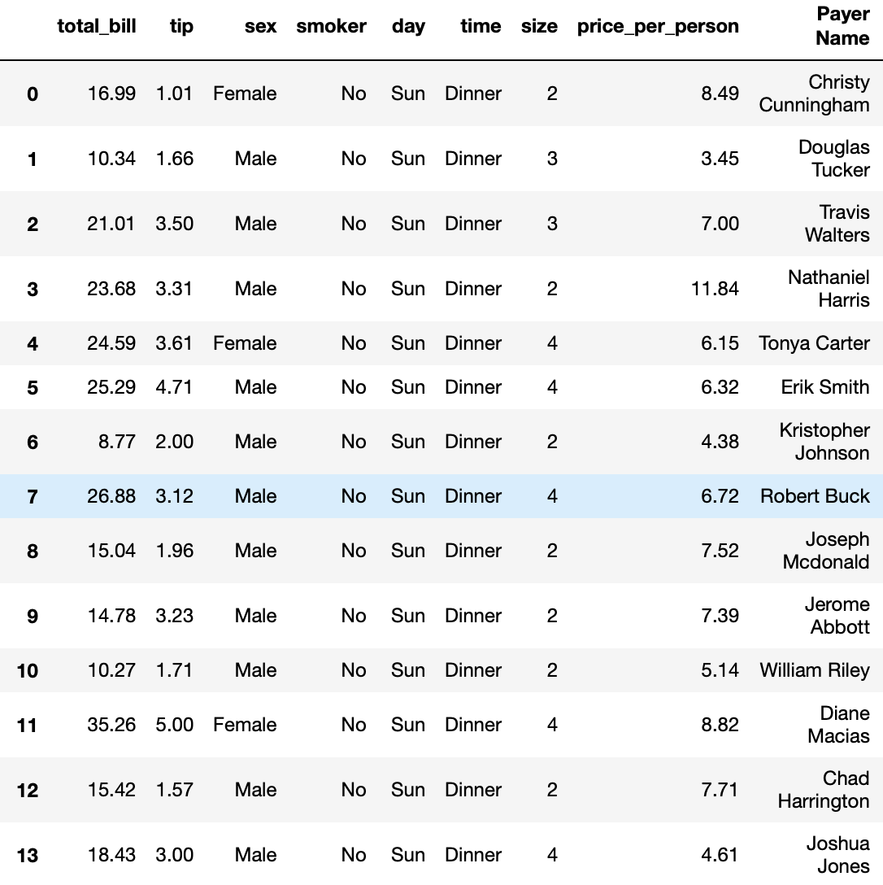
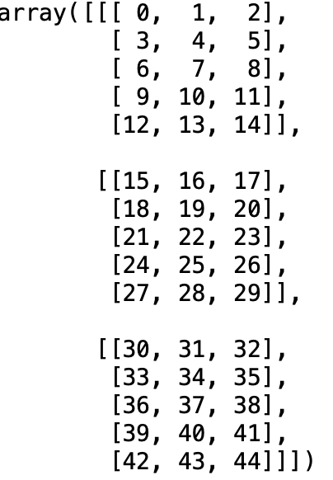
Basics of Pandas
Pandas are fast and easy tool for data analysis and data cleaning.
Pandas are used generally with tables and heterogeneous data, while numpy is used for homogeneous and numerical data.
There are two types of data structures Series & Dataframe. Series can be thought as dictionary mapping index to value

Slide 52
What Can be Done With Pandas
Reshaping
Slice, Index, Fancy Indexing, Sub setting
Size Mutability (change the size of dataframe)
Merge & Join dataset
Aggregation and Transforming using Group By

Slide 53
Data Ingestion in Pandas
Two ways to import data
Copy the path of the file from your local system
Upload the data in folder or python & read the data
Above methods can be applied to type of data files
Excel
CSV
Parquet
JSON
Txt
Same steps & method to export data back

Slide 54
Pandas Data Frame
#print(df.shape)
#print (df.isnull().sum())
#print (df.dtypes) (object example in integer column)
#print (df.columns)
#print (df.head())
#print(df.tail())
#df.copy()
Replace value in a row
drop column or columns, row or rows
Add a column
Set/Reset index

Slide 55
LOC & iLOC in Pandas
There are various syntax to index a particular value or a range of value in a series or a dataframe.
By Position
By Label
To make dataframe specific columns
Df[[ ]]
LOC: For row labels
Df.Set_index
X[“index name”]
X[“index name”,[“column 1”, column 3”]]
iLOC: For integer values
X[0]
X[0,[1,3]]

Slide 56
Slicing in Loc & iLoc
df.set_index(“equipment number”)
df.loc[:17202899,:]
df.loc[:17202899,:"ship-to city"]
df.iloc[0:3,:]
df.iloc[0:3,:6]

Slide 57
Sorting & Ranking
d={"col1":[100,200,300],
"col3":[10,20,30],
"col2":[1,2,3]}
df=pd.DataFrame(d)
Df.sort_index() (sorting of index)
Df.sort_index(axis=1) (column name sorting)
Df.sort_values(by=[‘col2’])
df.rank() (column wise ranking)
df.rank(axis=1) (row wise ranking)

Slide 58
Workflow of Data Science Projects
Data Science Workflow
EDA
Identifying Business Problem
Ingestion of Data
Preparing Data
Sharing Data Insights
AI (ML & Deep Learning)
Drop or Impute data
Handling Duplicate data
Binning & Slicing
Outlier Detection
Data Transformation
Excel
CSV
SQL
JSON
Different databases

Slide 59
Data Pre-Processing
#print(df.shape)
#print (df.isnull().sum())
#print (df.dtypes) (object example in integer column)
#print (df.columns)
#print (df.head())
#print(df.tail())
#df.copy()
Replace value in a row
drop column or columns, row or rows
Add a column
Set/Reset index

Slide 60
Data Pre-Processing
Unique
Nunique
Value Counts
Loop for (value_counts, unique, nunique)
Upper/lower string

Slide 61
Data Cleaning Dealing NA Values
3 ways to Treating NA Values
Drop NA Values
df_new1=df.dropna(axis=0) #0 for row 1 for column
df_new1=df.dropna(how=(”any")) #all if all the values are null for row or column
df_new=df.dropna(subset=[""])
Impute a statistical value or Interpolate
df4=df.fillna(df.mean())
df.fillna(df["industry code"].mean())
df7=df.fillna(df.rolling(67,min_periods=3).mean())
df6=df.interpolate(method="polynomial", order=2)
Give a constant value to NA values
df_new2=df.fillna(99)

Slide 62
Data Cleaning Dealing with Duplicate Values
To check if there are any duplicate
Df.duplicated()
Df[“column name”].duplicated(keep=“last”) by default it is first
To drop duplicate
Df.drop_duplicates()
Df.drop_duplicates(subset=“company code”)
Df.drop_duplicates(subset=“company code”, keep=“last”)

Slide 63
Function Allocation & Mapping: Apply & Applymap
Function can be applied to each row or column depending on axis specified by default it applies column wise.
Column wise function logic apply
f=lambda x:x.max()
df1=df[["industry segment","industry code","equipment fse number", "active contract number"]]
df1.apply(f)
Row wise function logic apply
df.apply(f, axis=1)
Applymap for element wise logic apply
f1=lambda x:x*10
df1.applymap(f1)

Slide 64
Work To DO
Create a new column named ”logic date”
With first value as equipment install date if equipment install date is not available then
Second preference to equipment shipped date if equipment shipped date is not available then
Last preference to equipment created on
If none out of 3 available drop those records
Calculate ageing (in days) of every equipment number with today’s day
Variable for ageing to be used is “logic date” created above & today’s date
Clean below mentioned columns (remove leading zeros)
Bill-to customer number
Sold-to customer number
Ship-to customer number
Clean the ship-to city column* (which city is highest time repeated)

Slide 65
Filtering Pandas DataFrame
Numerical variable filtering
>, <, ==,!=
String variable filtering
Exact match ==“LSI”
Substring matching (column filtering should be cleaned without any NA values)
Use ~ to remove null values from column & then substring matching
Combination of String & Number, Number & Number, String & String
& (and)
| (or)
Substring with |
Substring with &

Slide 66
Data Wrangling/Munging
Concatenation, also known as stacking (side-by-side or on top-to-bottom)
Pd.concat([])
Axis=0 & 1
Keys[“”,””]
Ignore_index
Merging of dataset
Left
Right
Intersection
Union
Left-anti
Right-anti

Slide 67
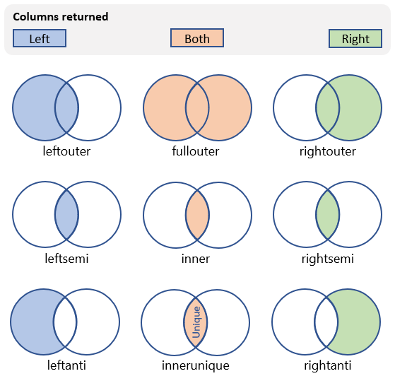

Slide 68
Data Aggregation & Grouping
Split Pandas
Calculate group summary statistics like count, mean, std deviation etc.
Transformation like rank & subset selection
Pivot Tables & Cross Tabulation
How to categorize information into dataframe

Slide 69
Data Aggregation & Grouping
Data aggregation & grouping is like apply, split & combine all together in one piece of code.
Key | Value
A | 10
C | 30
B | 20
C | 30
A | 10
B | 20
B | 20
A | 10
C | 30
A | 10
A | 10
A | 10
B | 20
B | 20
B | 20
C | 30
C | 30
C | 30
Sum/Count/Mean/Unique/Nunique

Slide 70
Statistics

Slide 71
Statistics In Python
Outlier detection
By describing the summary
Identifying the observation having outliers.
Random Sampling
pd.DataFrame(np.random.randn(10).reshape(5,2),columns=["col1","col2"])
With Replacement
Subset of observations are selected randomly, and an observation may be selected more than once.
df.sample(3)
Without Replacement
Subset of the observations are selected randomly, and once an observation is selected it cannot be selected again
Df.sample(3,replace=True)
For Categorical Variable
x=pd.get_dummies(df["corrected division"])
df.join(x)

Slide 72
Bucketing & Binning
Bucket & bin the data into small parts
Useful to segregate data into desired variables
Makes big data into useful one
Separates the noisy or not useful data
Easy to create

Slide 73
Bucketing & Binning
mean=np.round(df["Ageing of the product (in years)"].mean(),2)
df["Ageing of the product (in years).Average"]=np.where(df["Ageing of the product (in years)"]< mean,"below average","above average")
conditions=[(df["Ageing of the product (in years)"]<=3),
(df["Ageing of the product (in years)"]>3) & (df["Ageing of the product (in years)"]<=7),
(df["Ageing of the product (in years)"]>7) & (df["Ageing of the product (in years)"]<=14),
(df["Ageing of the product (in years)"]>14) & (df["Ageing of the product (in years)"]<=20),
(df["Ageing of the product (in years)"]>20), df["Ageing of the product (in years)"].isnull()]
values=["new product purchased", "check for service", "service requirment", "need replacement", "need replacement immidieately", "Missing"]
df["Bucketing/Binning"]=np.select(conditions,values)
df["Bucketing/Binning"].value_counts().plot(kind='bar')
df["Bucketing/Binning"].value_counts()

Slide 74
MATPLOTLIB

Slide 75
Workflow of Data Science Projects
Data Science Workflow
EDA
Identifying Business Problem
Ingestion of Data
Preparing Data
Sharing Data Insights
AI (ML & Deep Learning)
Drop or Impute data
Handling Duplicate data
Binning & Slicing
Outlier Detection
Data Transformation
Matplotlib
Seaborn
Correlation Plot
Value Count Plot
Different Visuals
Bar
Histogram
Pie
Boxplot
Excel
CSV
SQL
JSON
Different databases

Slide 76
MatPlotLib
Introduction
Matplotlib is the "grandfather" library of data visualization with Python. I
t was created by John Hunter. He created it to try to replicate MatLab's (another programming language) plotting capabilities in Python.
So if you happen to be familiar with matlab, matplotlib will feel natural to you.
It is an excellent 2D and 3D graphics library for generating scientific figures.
Some of the major Pros of Matplotlib are
Generally easy to get started for simple plots
Support for custom labels and texts
Great control of every element in a figure
High-quality output in many formats
Very customizable in general

Slide 77
Installation
You'll need to install matplotlib first with either:
conda install matplotlib or
pip install matplotlib
Common Mistakes
Import matplotlib as plt
DON'T FORGET THE .PYPLOT part
import matplotlib.pyplot as plt
If you are using an older version of jupyter, you need to run a "magic" command to see the plots inline with the notebook. Users of jupyter notebook 1.0 and above, don't need to run the cell below:
%matplotlib inline
Users running .py scripts in an IDE like PyCharm or Sublime Text Editor. You will not see the plots in a notebook, instead if you are using another editor, you'll use: *plt.show()* at the end of all your plotting commands to have the figure pop up in another window.

Slide 78

MatplotLib Methods

Slide 79
Types of Plot Available
Bar Graph
Multiple Bar Graphs
BoxPlot
Histogram
Pie Chart
Scatter Plot

Slide 80
Bar Graph & Types of Bar Graph
Simple Bar graph
Uses the two axes – x-axis and y-axis to plot rectangular bars. One of the axes represents the observation/category which is usually a fixed variable, while the other axis represents the numerical magnitude that the observation carries.
Horizontal Bar Graph
Same like simple bar graph just the axes are inter-change
Stacked Bar Graph
The difference between bar graph & stacked bar graph is that all the parameters are represented in a single bar. So you can say that there are segments of a total in a single bar.
Multi Bar Graph/ Grouped Bar Graph
When we want to compare two or more bodies or quantities with the same variables at that time multi bar graph is very useful

Slide 81
Bar Graph & Types of Bar Graph
Simple Bar graph
langs = ['C', 'C++', 'Java', 'Python', 'PHP']
student1 = [23,17,35,29,12]
plt.bar(langs,student1)
plt.show()
Stacked Bar Graph
langs = ['C', 'C++', 'Java', 'Python', 'PHP']
student1 = [40,17,35,29,12]
student2=[40,80,10,55,43]
plt.bar(langs, student1, color='r')
plt.bar(langs,student2, bottom=student1, color=‘b’)
Multiple Bar Graph/ Grouped Bar Graph
x=np.arange(4)
labels = ['C', 'C++', 'Java', 'Python']
plt.bar(x,[10,20,30,40],color="b",width=0.25,label="one")
plt.bar(x+.25,[40,25,50,50],color="r",width=0.25)
plt.xticks(x,labels, rotation='horizontal')
plt.show()

Slide 82
Histogram
A histogram is a graphical representation of data points organized into user-specified ranges. Similar in appearance to a bar graph, the histogram condenses a data series into an easily interpreted visual by taking many data points and grouping them into logical ranges or bins.
plt.hist(np.random.rand(100), bins=10)
plt.show()
What’s the difference between Histogram & Bar graph?

Slide 83
Scatter Graph
When trying to determine whether the two variables are related, such as: When trying to identify potential root causes of problems.
Used in correlation and regression, to check for the assumptions
x = np.array([5,7,8,7,2,17,2,9,4,11,12,9,6])
y = np.array([99,86,87,88,111,86,103,87,94,78,77,85,86])
plt.scatter(x, y)
plt.show()

Slide 84
Pie Chart
A pie chart helps organize and show data as a percentage of a whole.
It shows overall percentage or market share occupied
y = np.array([35, 25, 25, 15])
mylabels = ["Apples", "Bananas", "Cherries", "Dates"]
plt.pie(y, labels = mylabels)
plt.show()

Slide 85
Box Plot
Used in statistical analysis
Used for the outliers
Used to know the spread the of the data
data = np.random.normal(100, 20, 200)
fig = plt.figure(figsize =(10, 7))
plt.boxplot(data)
plt.show()

Slide 86
Figure & Subplot
Create a figure object
Fig=plt.figure()
Add plot to the figure object
Fig.add_subplot(2,2,1)
2 rows, 2 columns and 1st plot in it
Fig.add_subplot(2,2,2)
2 rows, 2 columns & 2nd plot in it
fig=plt.figure()
ax1=fig.add_subplot(2,2,1)
ax2=fig.add_subplot(2,2,2)
ax3=fig.add_subplot(2,2,3)
ax4=fig.add_subplot(2,2,4)

Slide 87
Figure & Subplot
x = np.array([5,7,8,7,2,17,2,9,4,11,12,9,6])
y = np.array([99,86,87,88,111,86,103,87,94,78,77,85,86])
z = np.array([35, 25, 25, 15])
mylabels = ["Apples", "Bananas", "Cherries", "Dates"]
fig=plt.figure()
ax1=fig.add_subplot(2,2,1)
ax2=fig.add_subplot(2,2,2)
ax3=fig.add_subplot(2,2,3)
ax4=fig.add_subplot(2,2,4)
ax1.hist(np.random.rand(100), bins=20)
ax2.plot(np.random.rand(100))
ax3.scatter(x, y)
ax4.pie(z, labels = mylabels)
plt.show()

Slide 88
Figure & Subplot (Alternate with less code)
x = np.array([5,7,8,7,2,17,2,9,4,11,12,9,6])
y = np.array([99,86,87,88,111,86,103,87,94,78,77,85,86])
z = np.array([35, 25, 25, 15])
mylabels = ["Apples", "Bananas", "Cherries", "Dates"]
fig,axis=plt.subplots(2,2)
axis[0,0].hist(np.random.rand(100),bins=10)
axis[0,1].plot(np.random.rand(100))
axis[1,0].scatter(x, y)
axis[1,1].pie(z,labels=mylabels)
plt.show()

Slide 89
Fig & Subplots Properties
Sharex
Sharey
Fig size
Wspace
hspace
Color
marker
style
Legend for every plot
X-Axis & Y-Axis labels & Title label
X-Axis & Y-Axis labels & Title label in a dictionary

Slide 90
Fig & Subplots Properties
fig,axis=plt.subplots(2,2,sharex=True,sharey=True, figsize=(6,8))###gridspec_kw={'width_ratios': [1, 2]}
plt.subplots_adjust(wspace=0,hspace=0)
axis[0,0].hist(np.random.rand(100),bins=10,color="r", label="histo")
axis[0,0].legend(loc="best")
axis[0,0].set_xlabel("xlabel")
axis[0,0].set_ylabel("ylabel")
axis[0,0].set_title("first plot")
axis[0,1].plot(np.random.rand(100),color="g",linestyle="--", marker="o")
plot_label={'title':'Second Plot',
'xlabel':'X-Axis'}
axis[0,1].set(**plot_label)
axis[1,0].scatter(x, y,color="y")
axis[1,1].pie(z,labels=mylabels)
plt.show()

Slide 91
Seaborn Correlation & Isnull
sns.heatmap(df.isnull(),cbar=True)
corr=df.corr()
plt.figure(figsize=(30,20))
plt.title('Pearson Correlation of Features', y=1, size=40)
sns.heatmap(corr,linewidths=-1,vmax=1.0,square=True, cmap='hot', linecolor='Black',annot=True)
plt.show()

